Slide 1
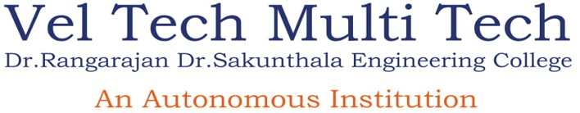
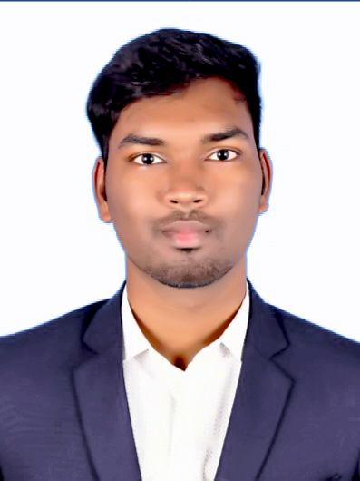
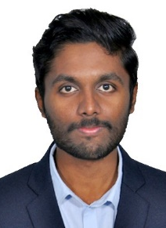
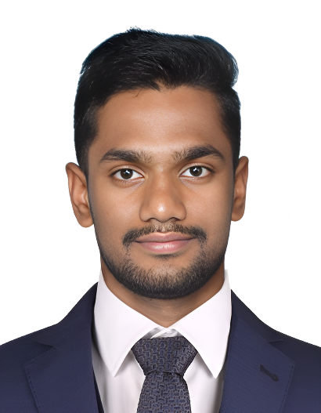
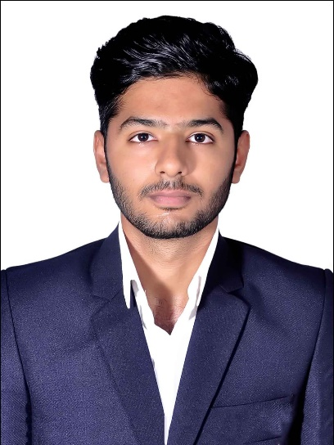
Department of Computer Science and Engineering
Real-Time Sign Language Translator
for Specially abled
Team Members:
Guided by, Dr.R.Saravanan , B.E, M.E, PhD,
Professor CSE Dept.
BATCH : 01
DATE : 24.05.2023
Devanand M
113119UG03019
Dhinesh M
113119UG03020
Veluru Balaji
113119UG03112
Komesh S
113119UG03051

Slide 2
OUTLINE OF THE PRESENTATION
Objective
Abstract Introduction Motivation Problem statement
Software and Hardware Requirement Proposed Work
Result
Conclusion & Future work References

Slide 3
OBJECTIVE
Communication has a significant impact in every domain.
The meaning of thoughts and expressions is important in communication.
Researchers are attracted to bridge the communication gap for every living being.
The objective of this project is to identify symbolic expressions through images.
The goal is to bridge the communication gap between normal and specially abled individuals.

Slide 4
ABSTRACT
Real-time sign language translator designed to improve communication between individuals who are deaf or hard of hearing and those who are not. We discuss the use of advanced technologies such as Mediapipe, Pytorch, and YOLOv5 to develop a lightweight CNN model with high accuracy, achieving 95.6%. Our model is used to predict sign language, and we have implemented it as a virtual cam that can translate sign language to subtitles on any video conference application using OBS software. Overall, our solution has the potential to significantly improve communication and accessibility for the deaf and hard of hearing community.

Slide 5
INTRODUCTION
The world is hardly live without communication, no matter whether it is in the form of texture, voice or visual expression.
The communication among the deaf and dumb people carried by text and visual expression.
Gestural communication is always in the scope of confidential and secure communication.
Hands and facial parts are immensely influential to express the thoughts of human in confidential communication.

Slide 6
MOTIVATION
Sign language is learned by deaf and dumb, and usually it is not known to normal people, so it becomes a challenge for communication between a normal and hearing impaired person.
Its strike to our mind to bridge the between hearing impaired and normal people to make the communication easier.
Sign language recognition (SLR) system takes an input expression from the hearing impaired person gives output to the normal person in the form text or voice

Slide 7
PROBLEM STATEMENT
Communication between deaf-mute individuals and normal people is challenging, especially during emergencies when conveying a message is crucial.
To address this problem, a Voice Conversion System with Hand Gesture Recognition and translation can be developed to facilitate effective communication between deaf-mute individuals and normal people in any language.
The lack of knowledge and training on hand sign language among normal individuals adds to the communication gap with deaf-mute individuals.
The development of such a system can help to bridge this communication gap and improve the quality of life for people with speech and hearing disabilities.

Slide 8
HARDWARE / SOFTWARE REQUIREMENTS
HARDWARE
: Windows 10 / 11
: Intel i3 9100F or later
: NVIDIA Ge Force GTX 1650 super (Nvidia Card only)
: 8GB RAM and 4GB VRAM (Recommended)
: 1920*1080 minimum display resolution
: Min. 720 pixels
Operating System
Processor Video card Memory Resolution Webcam
SOFTWARE
: VS Code, Nvidia Cuda, Nvidia Cnn
: TensorFlow , Keras , Open CV , MediaPipe , Flask , HTML , CSS , Java Script, PyTorch, Yolov5
Software Tool
Packages Used

Slide 9
PROPOSED WORK
The proposed engineering project aims to develop a Real-Time Sign Language Translator using Deep Learning techniques, specifically CNN, and popular machine learning libraries such as TensorFlow and PyTorch.
The system will incorporate object detection using YOLO v5 and OpenCV to improve the accuracy of hand gesture recognition.
The project will be implemented using Python programming language and deployed as a web application using Flask.
Web development tools such as HTML, CSS, JS, and Bootstrap will be utilized for the web application interface.
The Real-Time Sign Language Translator will recognize sign language gestures and translate them into text or speech in real-time.
The project will involve training the deep learning models on a large dataset of sign language gestures to improve the accuracy of the system.

Slide 10

OBS SOFTWARE
OBS is a free and open-source software for video recording and live streaming.
It allows users to capture video and audio from various sources like webcams and microphones.
Users can create scenes and customize them with different sources, sizes, and effects.
OBS supports popular streaming platforms and custom streaming servers.
It is compatible with Windows, macOS, and Linux operating systems.

Slide 11

OPEN CV
OpenCV is a huge open-source library for computer vision, machine learning, and image processing.
OpenCV supports a wide variety of programming languages like Python, C++, Java, etc.
It can process images and videos to identify objects, faces, or even the handwriting of a human.
When it is integrated with various libraries, such as Numpy which is a highly optimized library for numerical operations, then the number of weapons increases in your Arsenal i.e. whatever operations one can do in Numpy can be combined with OpenCV
With its vast array of features and easy-to-use API, OpenCV has become a popular choice for developers working on computer vision and image processing applications.

Slide 12

PYTORCH
PyTorch is an open-source machine learning library used for developing and training
deep learning models.
It provides a flexible and dynamic computational graph that allows for efficient model training and supports automatic differentiation.
PyTorch is primarily used for building neural networks and allows for fast computation on GPUs.
PyTorch provides a range of tools and utilities for data loading, visualization, and training, making it easier to develop and test deep learning models.
PyTorch is widely used in industry and academia, and is supported by major tech companies like Facebook and Microsoft.

Slide 13
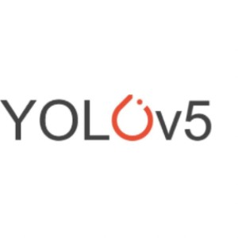
YOLO V5
YOLOv5 is a deep learning-based object detection algorithm that was introduced in 2020.
YOLOv5 is an acronym for "You Only Look Once version 5." It's a real-time object detection algorithm that can detect and classify multiple objects in an image or video stream.
YOLOv5 is built on a convolutional neural network architecture that includes a backbone of several convolutional layers, followed by detection heads that predict object locations and class probabilities.
YOLOv5 is a single-stage object detection algorithm, which means it directly predicts bounding boxes and class probabilities in a single forward pass of the neural network.
The YOLOv5 architecture includes several improvements over previous versions of YOLO, including a new focus on model scaling, better feature fusion, and improvements to the anchor box clustering process.

Slide 14
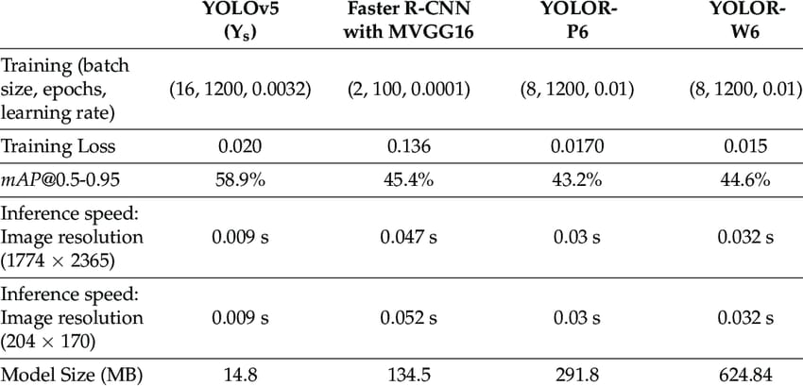
COMPARISON OF YOLOv5 WITH OTHERS

Slide 15
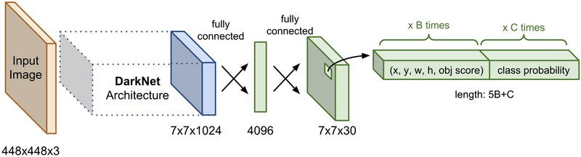
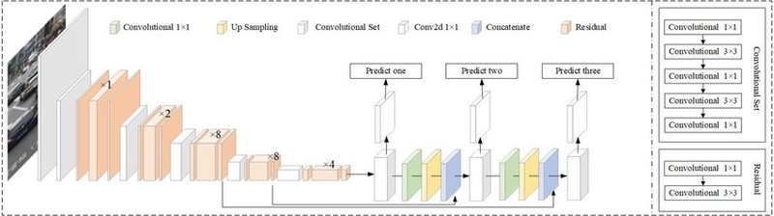
YOLOv5 ARCHITECTURE DIAGRAM
Yolo v5 model
DarkNet Architecture

Slide 16

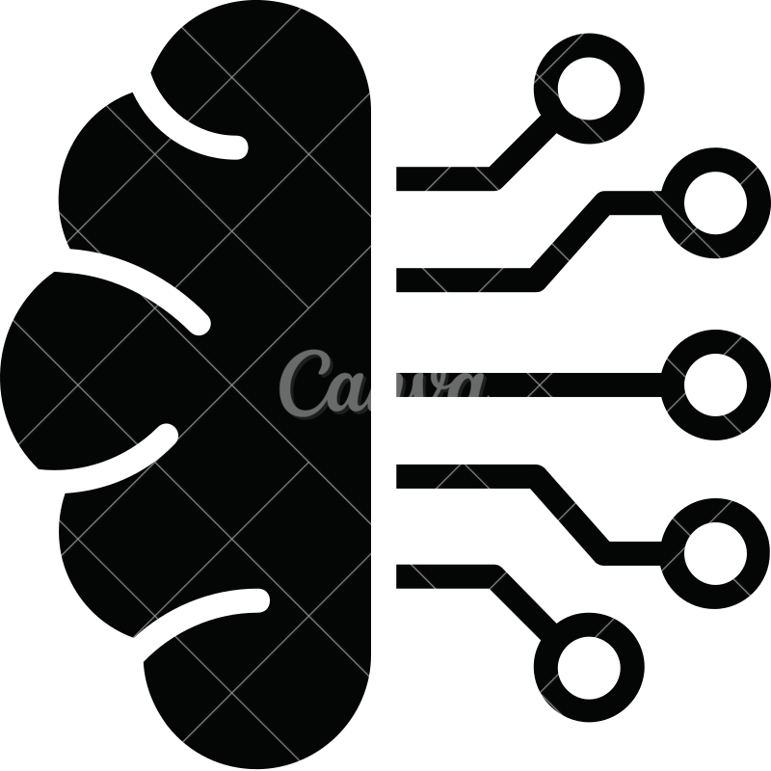


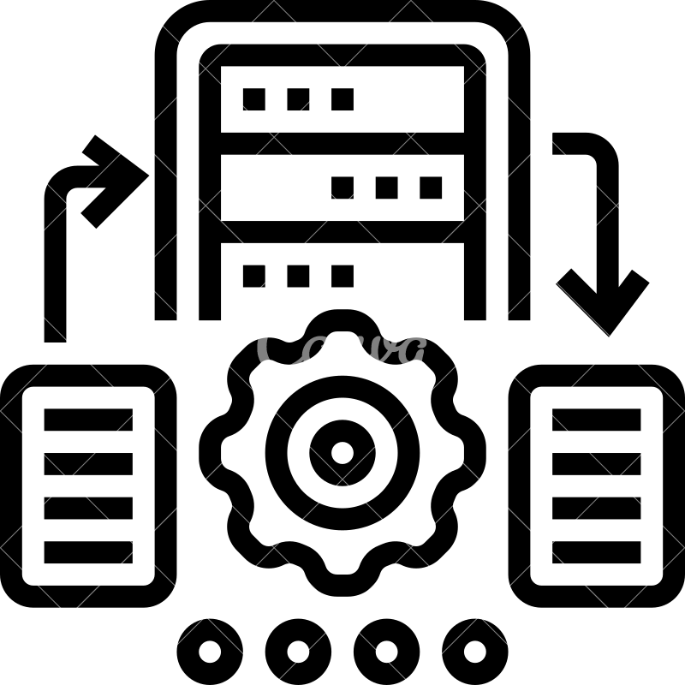


TECHNICAL ARCHITECTURE
Train data
Prediction
Evaluation
Image Dataset
Flask UI
Model
Neural Network
Image Processing
User
Image
Test data

Slide 17
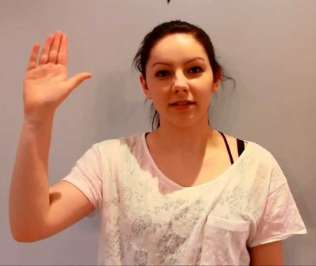
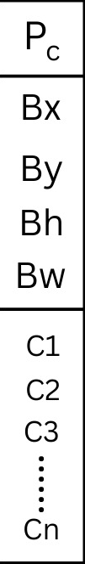
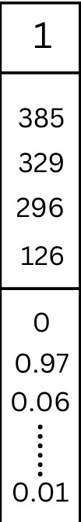
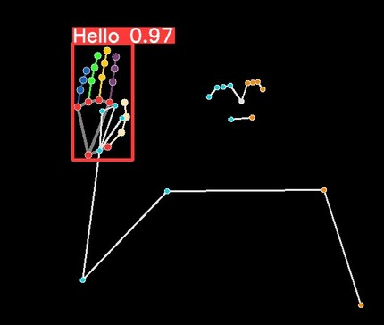
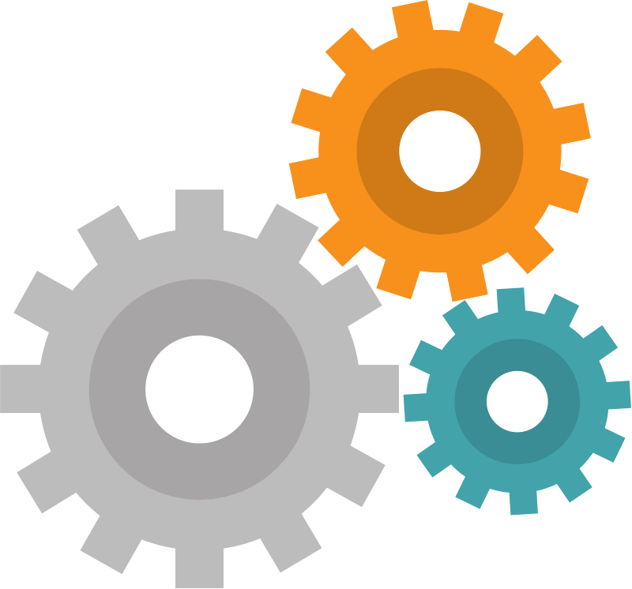
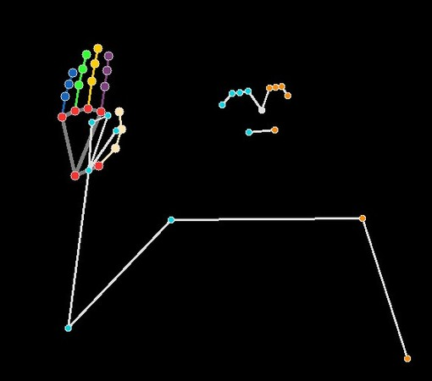
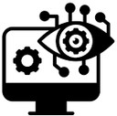
WORKING OF PREDICTION PROCESS
Precision Probability
YOLO
Predected Output
Bounding Box values
Input Video feed
YOLO Model
Class Probability
The class "HELLO" has the
highest probability of accuracy. So, it is considered as one of the
Computer Vision
most accurate class for the given image
PyTorch & Yolo v5 Model
Points & Connections extraction for holistic
CLASSIFICATION ALGORITHM

Slide 18
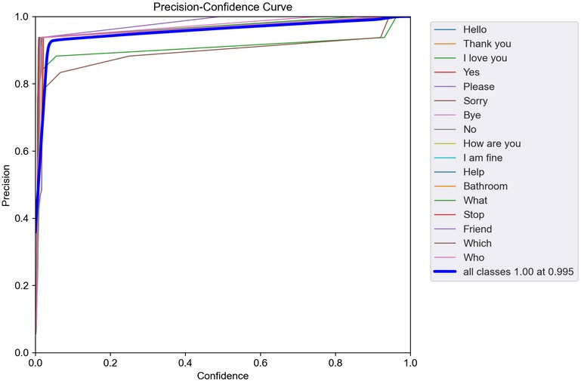
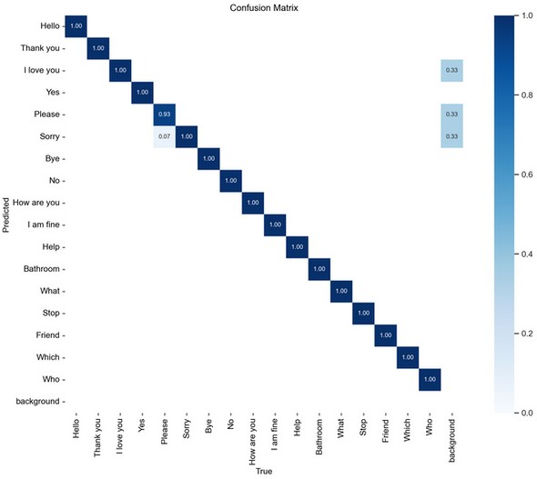
RESULT – CONFUSION MATRIX & PRECISION CURVE
Confusion Matrix
Precision Curve

Slide 19
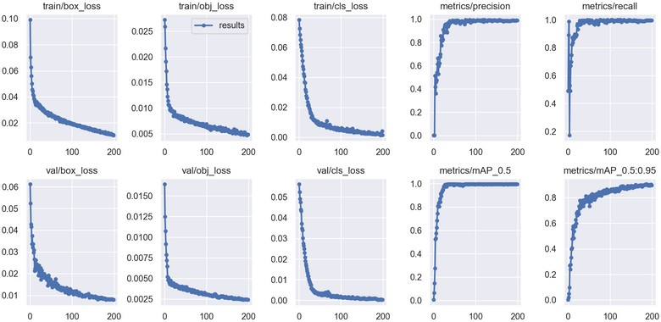
TRAINING ACCURACY & LOSS (200 EPOCHS)

Slide 20
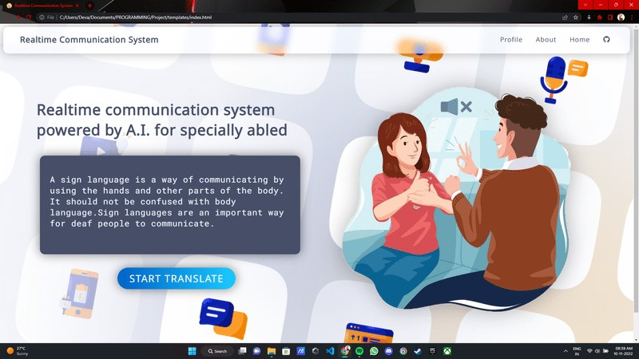
OUTPUT ( Main Screen )

Slide 21
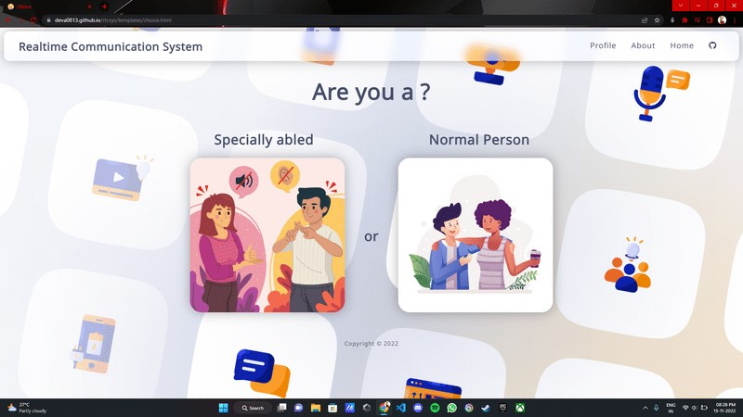
OUTPUT ( Choice Screen )

Slide 22
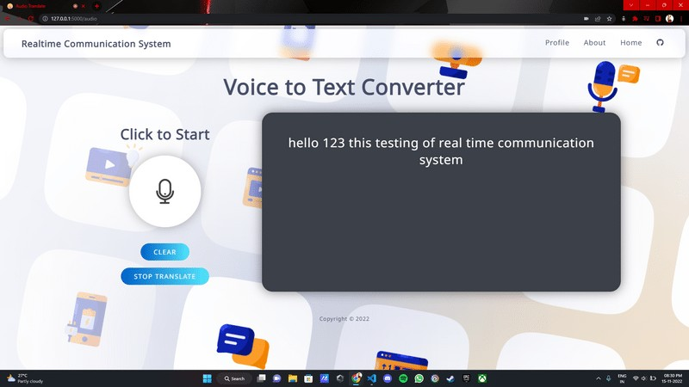
OUTPUT ( Audio Translate )

Slide 23
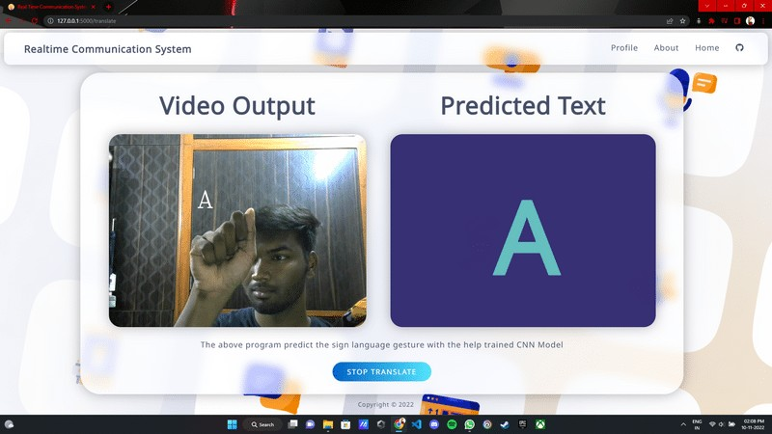
OUTPUT ( Video Translate )
This is the final output of our proposed work after implementing as web application

Slide 24
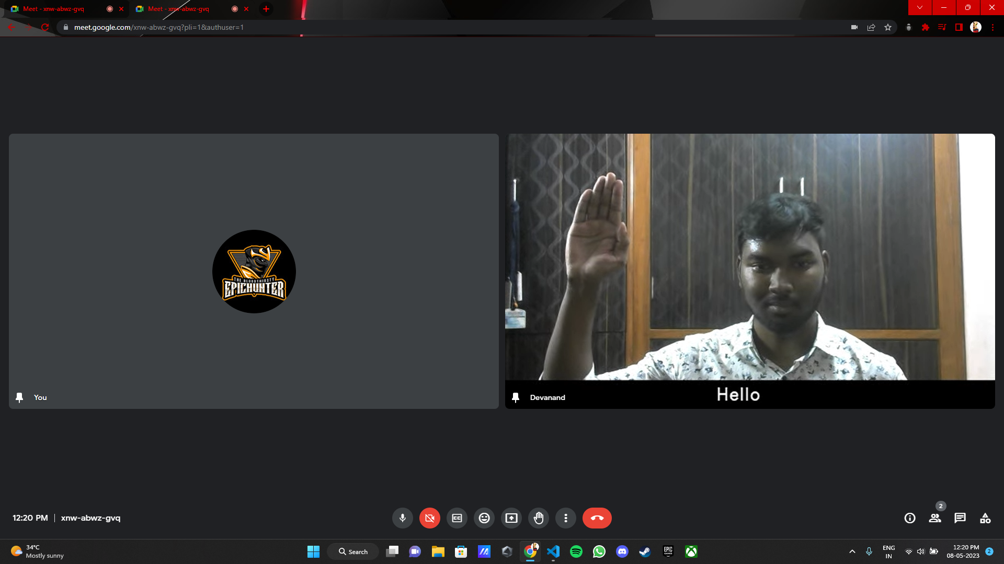
OUTPUT – Sign Language Translator Virtual Cam
Sign Language translator Virtual Cam used in Google meet video conference

Slide 25
CONCLUSION AND FUTURE WORK
In this project, we proposed an idea for feasible communication between hearing impaired and normal person with the help of deep learning and machine learning approach.
This proposed work ensures the accuracy of 90.2 (under good lighting condition) using YOLOv5 and Mediapipe.
The solution has the potential to increase the educational and employment opportunities of individuals who are deaf or hard of hearing, while also reducing feelings of social isolation and loneliness.
Overall, the real-time sign language translator represents a significant step forward in creating a more inclusive and accessible society for individuals with disabilities.

Slide 26
REFERENCES
[1] Sunitha K. A, Anitha Saraswathi.P, Aarthi.M, Jayapriya. K, Lingam Sunny, “Deaf Mute Communication
Interpreter- A Review”, International Journal of Applied Engineering Research, Volume 11, pp 290-296,
2016.
[2] “ A Review Paper on Sign Language Recognition for The Deaf and Dumb ” by R Rumana , Reddygari
Sandhya Rani , Mrs. R. Prema., published in ijert, 2021.
[3] “ An Automated System for Indian Sign Language Recognition ” by Chandandeep Kaur, Nivit Gill et al.,
International Journal of Advanced in Research in Computer Science and Software Engineering
[4] “ Hand Gesture Recognition using DenseNet201-Mediapipe Hybrid Modelling ” by Prachetas Padhi,
Mousumi Das et al,. published in IEEE in 2022.
[5] “ Real-Time Sign Language Translation Using Machine Learning and Deep Learning Techniques ” by
S. K. Saha et al., published in the International Journal of Computer Applications in 2019.

Slide 27
THANK YOU

